Slide 1
Providence Healthy Village Update:
Carroll Manor and Urgent Care
June 26, 2019
Nicole Commodore, JD
Director, Community Impact and Advocacy
Nicole.Commodore@ascension.org

Slide 2
Agenda
Carroll Manor Update
Urgent Care Update
Providence Healthy Village Q & A

Slide 3
Overview of Proposed Reorganization
Carroll Manor Nursing and Rehabilitation Center (the “Facility”) is a skilled nursing facility located at 725 Buchanan Street NE, Washington, DC. The Facility is currently owned and operated by Providence Hospital d/b/a Providence Health System and is affiliated with Ascension Health d/b/a Ascension.
Under this proposal, Carroll Manor would be a newly formed DC non-profit that will continue to be affiliated with Ascension Health.
The Proposed Reorganization is an internal reorganization between Providence Hospital and Carroll Manor that will result in Providence Hospital transferring all operations and assets associated with the Facility to Carroll Manor itself.

Slide 4
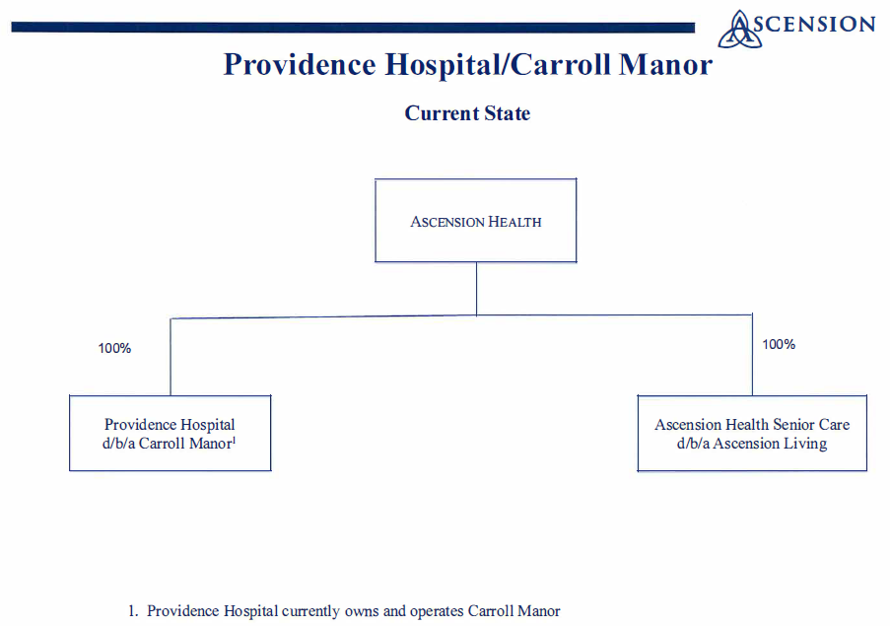
Organizational Structure – Current State

Slide 5
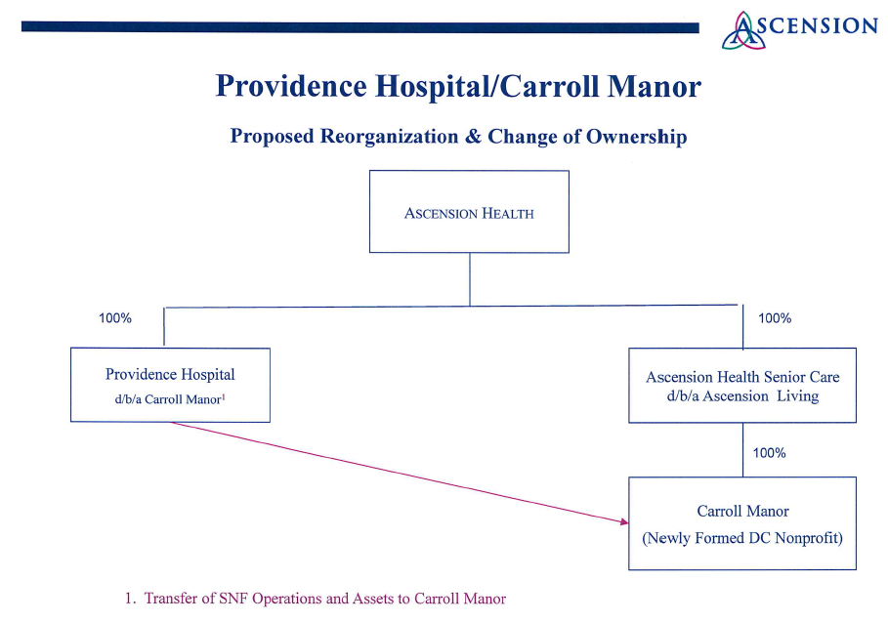
Organizational Structure – Proposed Reorganization

Slide 6
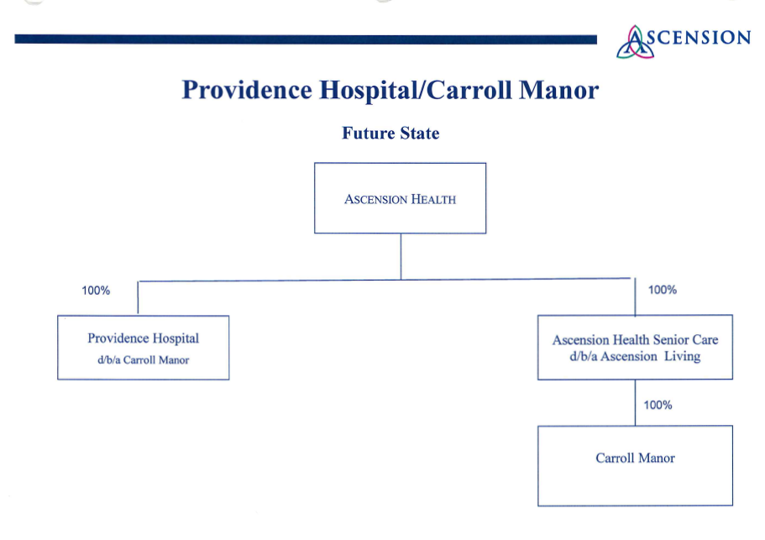
Organizational Structure – Proposed Reorganization

Slide 7
Ascension Living Operating Experience
In 2014, Ascension united majority of its senior-focused programs under the national organization of Ascension Living, creating the second-largest not-for-profit long-term care provider in the country
Ascension Living currently provides Mission-driven care to seniors in more than 50 locations across 13 states and the District of Columbia
Notable achievements:
  Named to the Best Nursing Homes in America List
  Joint Commission Accreditation
  More than 60% of Ascension Living skilled nursing facilities carry a CMS 4-star or 5-star overall rating
  High patient, resident satisfaction
The Facility has achieved a CMS 5-star overall rating.

Slide 8
Benefits of the Proposed Reorganization to Residents and Community
More focused, creative and effective approach to senior care
Facility residents will benefit from Ascension Living’s best practices and standardized systems
The Facility, its residents, and associates will benefit more directly and significantly from Ascension Living’s best practices and standardized systems, intellectual capital and strategies as they can be more effectively and efficiently shared and implemented consistently with all other Ascension Living communities
As part of the Proposed Reorganization, the Facility will become a direct part of Ascension Living and will also enable the Facility’s residents, family members and community to continue to experience the value, outcomes and involvement in decision-making they expect and deserve
  Ascension Living is the second-largest not-for-profit long-term care provider in the country

Slide 9
Impact of the Proposed Reorganization on Operations
Carroll Manor anticipates no changes to services after it acquires the Facility
Carroll Manor anticipates no material impact on the Facility’s staffing, work flows, or working environment for the Facility’s associates
  All existing associates will continue to be employed by Carroll Manor
  The Facility’s Director of Nursing and Executive Director will continue to lead the day-to-day operation and management of the Facility

Slide 10
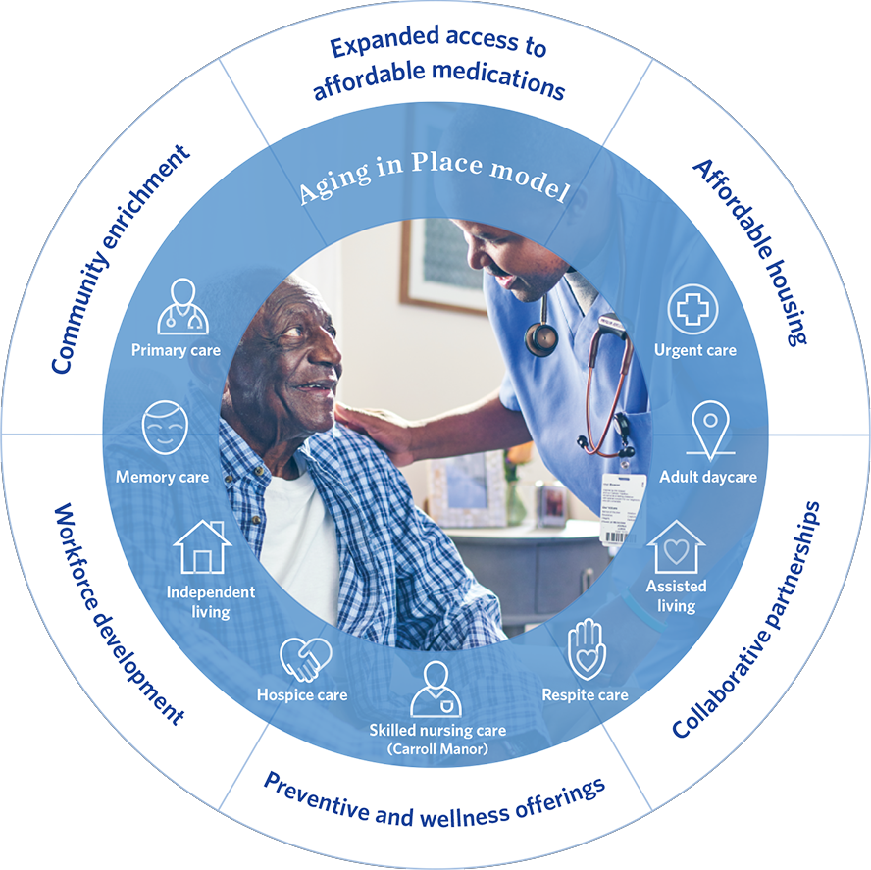
Carroll Manor – An Integral Part of the Providence Healthy Village
Key Services and Programs
Carroll Manor Skilled Nursing Facility
Expanded Senior Care – Assisted Living, Memory Care, and Adult Day Care
Urgent Care
Primary Care
Perry Family Health Center
Outpatient Behavioral Health
My Health GPS – Care coordination for Medicaid beneficiaries
Wellington Pharmacy / Dispensary of Hope
Care for Police Officers and Firefighters

Slide 11
Providence Urgent Care Center (UCC)
Opening on Tuesday, July 9, 2019 and Official Ribbon Cutting Ceremony and Celebration on Friday, August 2, 2019
Medical care will be provided on a walk-in, no-appointment basis for non-emergency acute illness or injury that is not life or limb threatening
We will serve all patients regardless of financial status
Seven days a week operation; 8:00am to 10:00pm on weekdays and 8:00am to 3:00pm on weekends
Complements the primary care services and meets population need

Slide 12
Providence Urgent Care Center (UCC) – Services and Treatments
In general, the things that are treated in urgent care facilities include:
Cold and Flu
Sprains, strains, and broken bones
Asthma
Ear infections
Bronchitis
Sinus infections and sinus pressure
Pink eye
Strep throat
Vaccinations
Radiology and other lab services

Slide 13
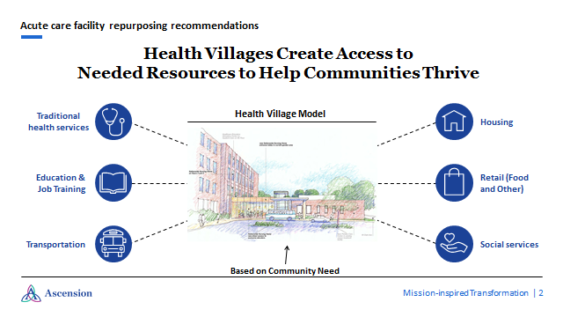
Future Healthy Village Components
A Healthy Village is a micro-community environment that not only provides traditional health care services but also provides access to other complementary resources and services needed to help the community thrive.
Examples of some complementary resources and services that may be available in our Providence Healthy Village include, social services, food security, transportation, education, affordable housing, and job training.

Slide 14
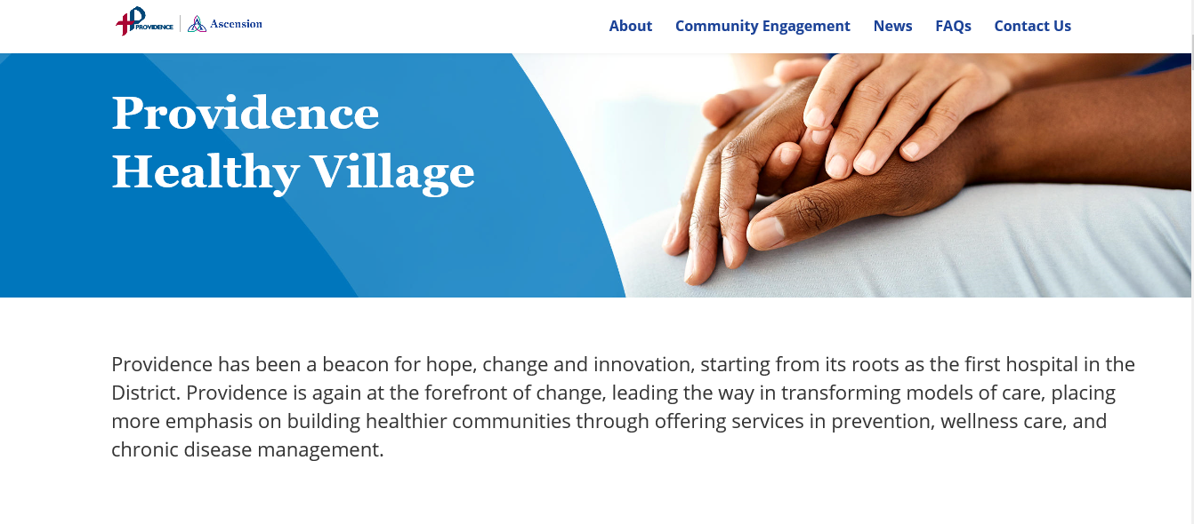
Providence Healthy Village Website
Providence is dedicated to delivering care that best serves our community’s needs.
For more information on our transformation, please visit us at www.ProvidenceHealthyVillage.org

Slide 15
We’d like your support
Please share your feedback and ideas with us at, communityrelationsdc@ascension.org
We are here to listen
Your voice makes a difference in how we will continue to transform the Providence campus
For regular updates and information, please visit www.ProvidenceHealthyVillage.org
Thank you for your continued commitment to this community.

Slide 16
Questions/Discussion

